Slide 1
Introduction to Operations Research

Slide 2
Operations research management focuses on the mathematical scoring of consequences of a decision aiming to optimize the use of time, effort, and resources to avoid blunders. The act of obtaining best results under any given circumstances is known as optimizing.
The key purpose of Operations Research (OR) is to do preparative calculations that aid the decision-making process.
Hence, decision-making is a key part of our daily life. The ultimate goal of all decisions is to maximize benefits and to minimize effort and time. OR gives decision makers the power to make effective decisions and improve day-to-day operations. Decision makers consider all the available options, study the outcomes, and estimate the risks.

Slide 3
In simple situations, common sense and judgement can be used to take decisions. For example, if you are buying a microwave or washing machine, the decision-making process is not very complicated. You can simply compare the price, quality, and durability of the well-known brands and models in the market and take a decision based on it.
However, in complex situations, although it is possible to take decisions based on one’s common sense, a decision backed by mathematical calculations reduces the risk factor and increases the probability of success. Some such situations, where decision-makers have to depend on mathematical scoring and reasoning, are finding an appropriate product mix amidst competitor’s products or planning a public transportation network in a city.

Slide 4
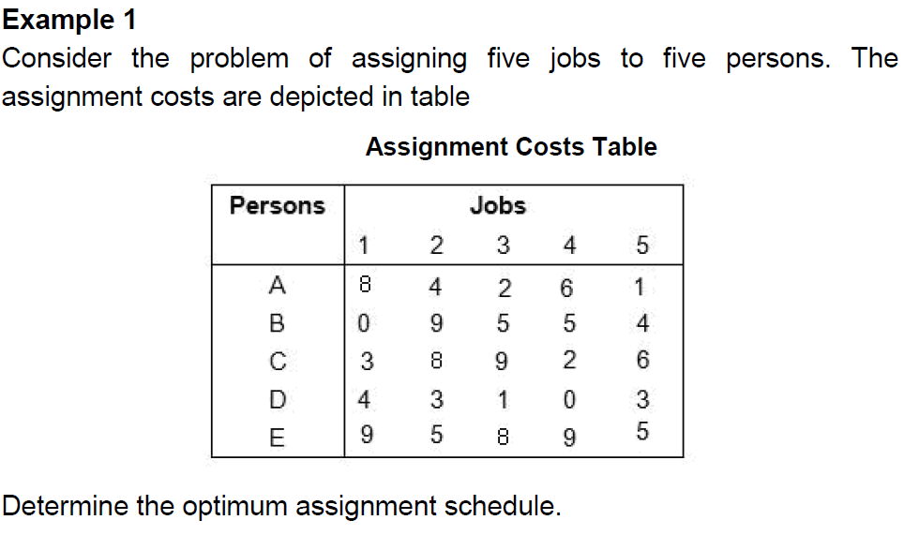

Slide 5

Persons/Jobs | 1 | 2 | 3 | 4 | 5
A | 7 | 3 | 1 | 5 | 0
B | 0 | 9 | 5 | 5 | 4
C | 1 | 6 | 7 | 0 | 4
D | 4 | 3 | 1 | 0 | 3
E | 4 | 0 | 3 | 4 | 0
Column reduced matrix will be the same as each column’s minimum value is zero.
Persons/Jobs | 1 | 2 | 3 | 4 | 5
A | 7 | 3 | 0 | 5 | 0
B | 0 | 9 | 4 | 5 | 4
C | 1 | 6 | 6 | 0 | 4
D | 4 | 3 | 0 | 0 | 3
E | 4 | 0 | 2 | 4 | 0

Slide 6
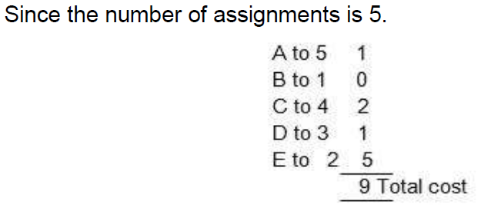
Then you can start assigning the jobs as depicted in table
Persons/Jobs | 1 | 2 | 3 | 4 | 5
A | 7 | 3 | 0 | 5 | 0
B | 0 | 9 | 4 | 5 | 4
C | 1 | 6 | 6 | 0 | 4
D | 4 | 3 | 0 | 0 | 3
E | 4 | 0 | 2 | 4 | 0
Therefore, the optimum assignment schedule is A to 5, B to 1, C to 4, D to 3, and E to 2.

Slide 7
Objectives:
After studying this unit, you should be able to:
• describe the historical background of OR
• list the significant features of OR
• describe the methodology of OR
• define the structure of a mathematical model in OR
• describe the significance of the function of OR

Slide 8
Historical Background
During the World War II, scientists from United Kingdom studied the strategic and tactical problems associated with air and land defence of the country. The aim of this study was to determine the effective utilization of limited military resources to win the battle. The technique was named operations research.
After World War II, operations research techniques were developed and deployed in the decision-making process in complicated situations in various fields, such as industrial, academic, and government organizations.

Slide 9
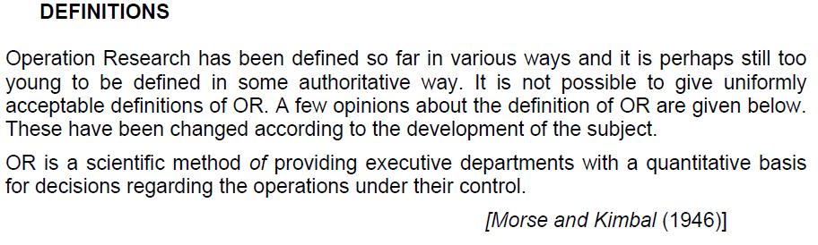
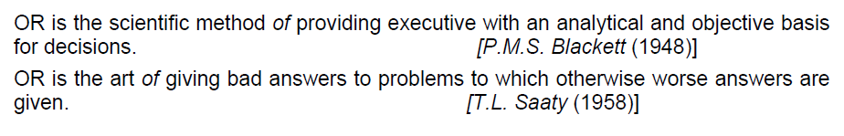

Slide 10
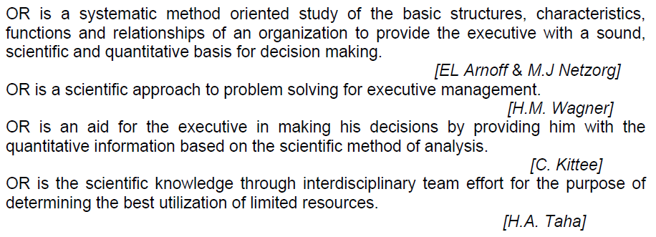

Slide 11
Scope of Operations Research
Any problem, either simple or complicated, can use OR techniques to find the best possible solution.
In defence operations
In industry
Planning
Agriculture
In hospitals
In transport
Research and development

Slide 12
Features of Operation Research
Some key features of OR are as follows:
• OR is system-oriented. OR scrutinizes the problem from an organization's perspective. The results can be optimal for one part of the system, while the same can be unfavorable for another part of the system.
• OR imbibes an inter–disciplinary team approach. Since no single individual can have a thorough knowledge of all the fast developing scientific know-how, personalities from different scientific and managerial cadre form a team to solve the problem.
• OR uses scientific methods to solve problems.
• OR increases effectiveness of the management’s decision-making ability.
• OR uses computers to solve large and complex problems.
• OR offers a quantitative solution.

Slide 13
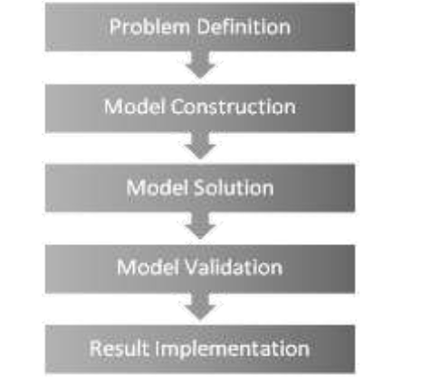


Slide 14
Limitations of Operations Research
The limitations are more related to the problems of model building, time, and money factors.
The limitations are:
• Magnitude of computation – Modern problems involve a large number of variables. The magnitude of computation makes it difficult to find the interrelationship.
• Intangible factors – Non–quantitative factors and human emotional factors cannot be taken into account.
• Communication gap – There is a wide gap between the expectations of managers and the aim of research professionals.
• Time and money factors – When you subject the basic data to frequent changes then incorporating them into OR models becomes a costly affair.
• Human factor – Implementation of decisions involves human relations and behaviour.

Slide 15
* Sample Questions
1. Define OR.
2. Recall features of OR.
3. Recall scope of OR.
4. Recall limitations of OR.

Slide 16
